Slide 1
Fundamentals of Artificial Intelligence
Local Search Algorithms

Slide 2
Local Search
The uninformed and informed search algorithms that we have seen are designed to explore search spaces systematically.
They keep one or more paths in memory and by record which alternatives have been explored at each point along the path.
When a goal is found, the path to that goal also constitutes a solution to the problem.
In many problems, however, the path to the goal is irrelevant. (8 QUEEN)
If the path to the goal does not matter, we might consider a different class of algorithms that do not
worry about paths at all.
🡺 local search algorithms

Slide 3
Local Search
Local search algorithms operate using a single current node and generally move only to neighbors of that node.
Local search algorithms ease up on completeness and optimality in the interest of improving time
and space complexity?
Although local search algorithms are not systematic, they have two key advantages:
They use very little memory (usually a constant amount), and
They can often find reasonable solutions in large or infinite (continuous) state spaces.
In addition to finding goals, local search algorithms are useful for solving pure optimization problems, in which the aim is to find the best state according to an objective function.
In optimization problems, the path to goal is irrelevant and the goal state itself is the solution.
In some optimization problems, the goal is not known and the aim is to find the best state.

Slide 4
Hill Climbing Search
(Steepest Ascent/Descent)
At each iteration, the hill-climbing search algorithm moves to the best successor of the current node according to an objective function.
Best successor is the successor with best value (highest or lowest) according to an objective function.
If no successors have better value than the current value, it returns.
It moves in direction of uphill (hill climbing).
It terminates when it reaches a “peak” where no neighbor has a higher value.
The algorithm does not maintain a search tree, so the data structure for the current node need only record the state and the value of the objective function.
Hill climbing does not look ahead beyond the immediate neighbors of the current state.
Hill climbing is sometimes called greedy local search because it grabs a good neighbor state without thinking ahead about where to go next.
Greedy algorithms often perform quite well and
Hill climbing often makes rapid progress toward a solution.

Slide 5
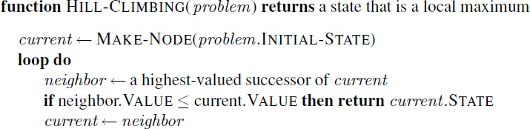
Hill Climbing Search
(Steepest Ascent/Descent)
best successor

Slide 6
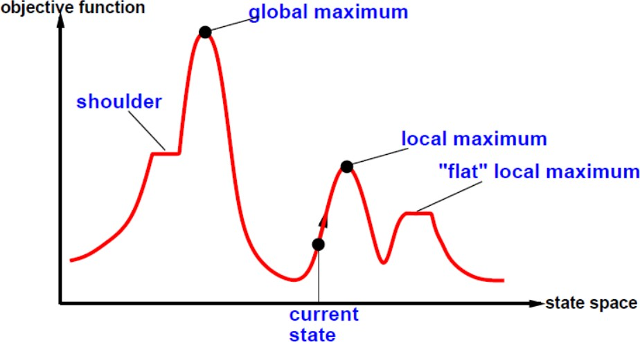
Hill Climbing Search
A local maximum is a peak that is higher than each of its neighboring states but lower than the
global maximum.
Hill-climbing algorithms that reach the vicinity of a local maximum will be drawn upward toward the peak but will then be stuck with nowhere else to go.
A plateau is a flat area of the state-space landscape. It can be a flat local maximum, from which no uphill exit exists, or a shoulder, from which progress is possible.
A hill-climbing search might get lost on the plateau.
Random sideways moves can escape from shoulders but they loop forever on flat maxima.

Slide 7
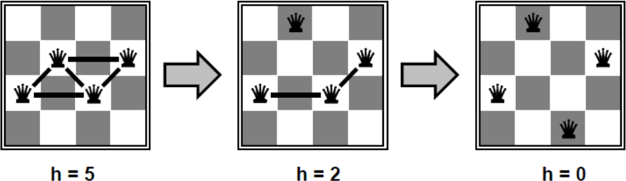
Hill Climbing Example
n-queens
Put n queens on an n × n board with no two queens on the same row, column, or diagonal
Move a queen to reduce number of conflicts.
🡺 Objective function: number of conflicts (no conflicts is global minimum)
The successors of a state are all possible states generated by moving a single queen to another square in the same column (so each state has n*(n-1) successors).
The heuristic cost function h is the number of pairs of queens that are attacking each other, either directly or indirectly.
The global minimum of this function is zero, which occurs only at perfect solutions.

Slide 8
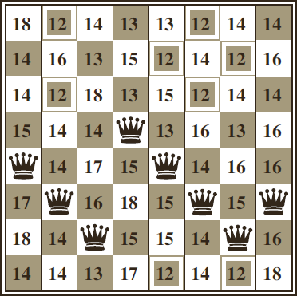
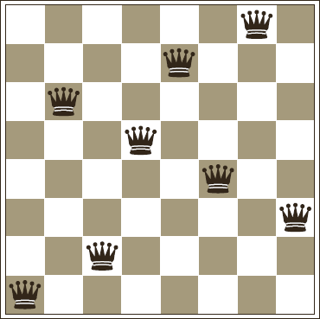
Hill Climbing Example
n-queens
Hill Climbing may NOT reach to a goal state for n-queens problem.
🡺 five steps to reach this state
An 8-queens state with heuristic cost estimate h=17
The value of h for each possible successor obtained by moving a queen within its column.
The best moves are marked with value 12.
A local minimum in the 8-queens state space; the state has h=1
but every successor has a higher cost.
Hill Climbing will stuck here

Slide 9
Hill Climbing Search
To understand local search, it is useful to consider the state-space landscape.
The aim is to find the highest peak - a global maximum.
Hill-climbing search modifies the current state to try to improve it.

Slide 10
Hill Climbing Example
n-queens
Starting from a randomly generated 8-queens state, steepest-ascent hill climbing gets stuck 86% of the time, solving only 14% of problem instances.
The Hill Climbing algorithm halts if it reaches a plateau.
One possible solution is to allow sideways move in the hope that the plateau is really a shoulder.
If we always allow sideways moves when there are no uphill moves, an infinite loop will occur whenever the algorithm reaches a flat local maximum that is not a shoulder.
One common solution is to put a limit on the number of consecutive sideways moves allowed.
For example, we could allow up to 100 consecutive sideways moves in the 8-queens problem. This raises the percentage of problem instances solved by hill climbing from 14% to 94%.

Slide 11
Hill Climbing Example
8-puzzle
Heuristic function is Manhattan Distance
1 | 4 | 2
 | 3 | 5
6 | 7 | 8
h = 3

Slide 12
Hill Climbing Example
8-puzzle
 | 4 | 2
1 | 3 | 5
6 | 7 | 8
Heuristic function is Manhattan Distance
h = 4
1 | 4 | 2
 | 3 | 5
6 | 7 | 8
1 | 4 | 2
3 |  | 5
6 | 7 | 8
h = 3
h = 2
1 | 4 | 2
6 | 3 | 5
 | 7 | 8
h = 4

Slide 13
Hill Climbing Example
8-puzzle
 | 4 | 2
1 | 3 | 5
6 | 7 | 8
1 | 4 | 2
 | 3 | 5
6 | 7 | 8
Heuristic function is Manhattan Distance
h = 4
h = 3
1 |  | 2
3 | 4 | 5
6 | 7 | 8
1 | 4 | 2
 | 3 | 5
6 | 7 | 8
1 | 4 | 2
3 |  | 5
6 | 7 | 8
h = 1
h = 2
1 | 4 | 2
3 | 5
6 | 7 | 8
h = 3
1 | 4 | 2
6 | 3 | 5
 | 7 | 8
h = 3
1 | 4 | 2
3 | 7 | 5
6 |  | 8
h = 4
h = 3

Slide 14
Hill Climbing Example
8-puzzle: a solution case
 | 4 | 2
1 | 3 | 5
6 | 7 | 8
1 | 4 | 2
 | 3 | 5
6 | 7 | 8
Heuristic function is Manhattan Distance
h = 4
h = 3
1 |  | 2
3 | 4 | 5
6 | 7 | 8
1 |  | 2
3 | 4 | 5
6 | 7 | 8
1 | 4 | 2
 | 3 | 5
6 | 7 | 8
1 | 4 | 2
3 |  | 5
6 | 7 | 8
h = 1
h = 0
h = 2
1 | 4 | 2
3 | 5
6 | 7 | 8
h = 3
1 | 4 | 2
6 | 3 | 5
 | 7 | 8
h = 3
1 | 4 | 2
3 | 7 | 5
6 |  | 8
h = 4
h = 3

Slide 15
Hill Climbing Example
8-puzzle: stuck at local maximum
2 |  | 3
1 | 8 | 4
7 | 6 | 5
1 | 2 | 3
7 | 8 | 4
 | 6 | 5
Heuristic function is Manhattan Distance
h = 13
h = 12
 | 2 | 3
1 | 8 | 4
7 | 6 | 5
1 | 2 | 3
 | 8 | 4
7 | 6 | 5
 | 2 | 3
1 | 8 | 4
7 | 6 | 5
We are stuck with a local maximum.
h = 12
h = 11
h = 12
1 | 2 | 3
8 |  | 4
7 | 6 | 5
h = 12

Slide 16
Hill Climbing
Hill Climbing is NOT complete.
Hill Climbing is NOT optimal.
Why use local search?
Low memory requirements – usually constant
Effective – Can often find good solutions in extremely large state spaces
Randomized variants of hill climbing can solve many of the drawbacks in practice.
Many variants of hill climbing have been invented.

Slide 17
Stochastic Hill Climbing
having a random probability distribution or pattern that may be analyzed statistically but may not be predicted precisely.
Stochastic hill climbing chooses at random from among the uphill moves;
The probability of selection can vary with the steepness of the uphill move.
Stochastic hill climbing usually converges more slowly than steepest ascent, but in some state
landscapes, it finds better solutions.
Stochastic hill climbing is NOT complete, but it may be less likely to get stuck.

Slide 18
First-Choice Hill Climbing
First-choice hill climbing implements stochastic hill climbing by generating successors randomly until one is generated that is better than the current state.
This is a good strategy when a state has many of successors.
First-choice hill climbing is also NOT complete,

Slide 19
Random-Restart Hill Climbing
Random-Restart Hill Climbing conducts a series of hill-climbing searches from randomly generated initial states, until a goal is found.
Random-Restart Hill Climbing is complete if infinite (or sufficiently many tries) are allowed.
If each hill-climbing search has a probability p of success, then the expected number of restarts required is 1/p.
For 8-queens instances with no sideways moves allowed, p ≈ 0.14, so we need roughly 7 iterations to find a goal (6 failures and 1 success).
For 8-queens, then, random-restart hill climbing is very effective indeed.
Even for three million queens, the approach can find solutions in under a minute.
The success of hill climbing depends very much on the shape of the state-space landscape:
If there are few local maxima and plateau, random-restart hill climbing will find a good solution very quickly.
On the other hand, many real problems have many local maxima to get stuck on.
NP-hard problems typically have an exponential number of local maxima to get stuck on.

Slide 20
Simulated Annealing
A hill-climbing algorithm that never makes “downhill” moves toward states with lower value (or higher cost) is guaranteed to be incomplete, because it can get stuck on a local maximum.
In contrast, a purely random walk—that is, moving to a successor chosen uniformly at random from the set of successors—is complete but extremely inefficient.
Therefore, it seems reasonable to combine hill climbing with a random walk in some way that yields both efficiency and completeness.
Idea: escape local maxima by allowing some “bad” moves but gradually decrease their size and frequency.
The simulated annealing algorithm, a version of stochastic hill climbing where some downhill moves are allowed.
Annealing: the process of gradually cooling metal to allow it to form stronger crystalline structures
Simulated annealing algorithm: gradually “cool” search algorithm from Random Walk to First-
Choice Hill Climbing

Slide 21
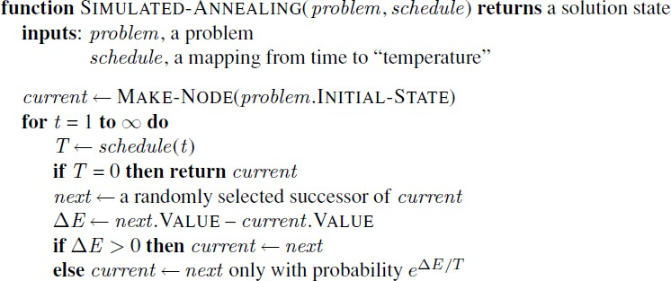
Simulated Annealing
Downhill moves are accepted readily early in the annealing schedule and then less often as time goes on.
The schedule input determines the value of the temperature T as a function of time.

Slide 22
Simulated Annealing
Instead of picking the best move, Simulated Annealing picks a random move.
If the move improves the situation, it is always accepted.
Otherwise, the algorithm accepts the move with some probability less than 1.
The probability decreases exponentially with the “badness” of the move—the amount ΔE by which
the evaluation is worsened.
The probability also decreases as the “temperature” T goes down: “bad” moves are more likely to be allowed at the start when T is high, and they become more unlikely as T decreases.
If the schedule lowers T slowly enough, the algorithm will find a best state with probability
approaching 1.
Simulated Annealing is widely used in VLSI layout and airline scheduling.

Slide 23
Local Beam Search
The local beam search algorithm keeps track of k states rather than just one.
It begins with k randomly generated states.
At each step, all the successors of all k states are generated.
If any one is a goal, the algorithm halts.
Otherwise, it selects the k best successors from the complete list and repeats.
The local beam search algorithm is not the same as k searches run in parallel!
In a local beam search, searches that find good states recruit other searches to join them.
In a random-restart search, each search process runs independently of the others.

Slide 24
Stochastic Beam Search
Problem: quite often, all k states end up on same local hill in local beam search algorithm
Idea: choose k successors randomly, biased towards good ones
🡺 Stochastic Beam Search
Instead of choosing the best k from the pool of candidate successors, stochastic beam search chooses k successors at random, with the probability of choosing a given successor being an increasing function of its value.
Stochastic beam search bears some resemblance to the process of natural selection, whereby the “successors” (offspring) of a “state” (organism) populate the next generation according to its “value” (fitness).

Slide 25
Genetic Algorithms
A genetic algorithm (GA) is a variant of stochastic beam search in which successor states are generated by combining two parent states rather than by modifying a single state.
Like beam searches, GAs begin with a set of k randomly generated states, called the population.
Each state, or individual, is represented as a string over a finite alphabet—most commonly, a string
of 0s and 1s.
An 8-queens state must specify the positions of 8 queens, each in a column of 8 squares, and so it requires 8× log2 8=24 bits.
Alternatively, the state could be represented as 8 digits, each in the range from 1 to 8.
Each state is rated by an objective function, or (in GA terminology) the fitness function.
Pairs of individuals are randomly selected for reproduction.
From each pair new offsprings (children) are generated using crossover operation.
A crossover point is chosen randomly from the positions in the string.
The offsprings are created by crossing over the parent strings at the crossover point.
Each child is subject to random mutation with a small independent probability.

Slide 26
Genetic Algorithms
A state can be represented using a 8 digit string.
Each digit in the range from 1 to 8 to indicate the position of the queen in that column.
🡺
1 6 2 5 7 4 8 3

Slide 27
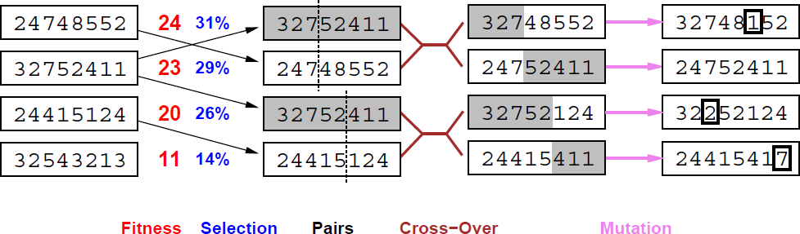
Genetic Algorithms
The initial population has 4 states.
A fitness function should return higher values for better states, so, for the 8-queens problem we use
the number of non-attacking pairs of queens, which has a value of 28 for a solution.
The values of the four states are 24, 23, 20, and 11.

Slide 28
Genetic Algorithms
The probability of being chosen for reproducing is directly proportional to the fitness score.
Two pairs are selected at random for reproduction, in accordance with the probabilities.
Notice that one individual is selected twice and one not at all.

Slide 29
Genetic Algorithms
The crossover points are after third digit in first pair and after fifth digit in second pair.
The first child of the first pair gets the first three digits from the first parent and the remaining digits from the second parent, whereas the second child gets the first three digits from the second parent and the rest from the first parent.

Slide 30
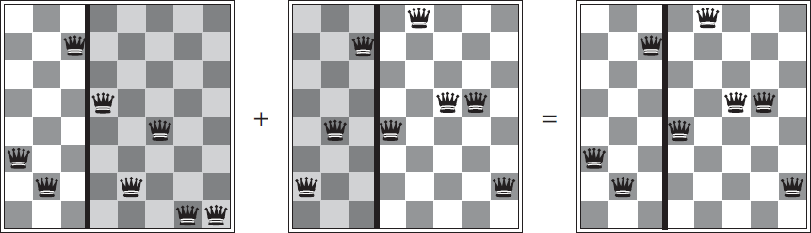



Genetic Algorithms
Crossover helps iff substrings are meaningful components.
The shaded columns are lost in the crossover step and the unshaded columns are retained.

Slide 31
Genetic Algorithms
One digit was mutated in the first, third, and fourth offspring.
In the 8-queens problem, this corresponds to choosing a queen at random and moving it to a random
square in its column.

Slide 32
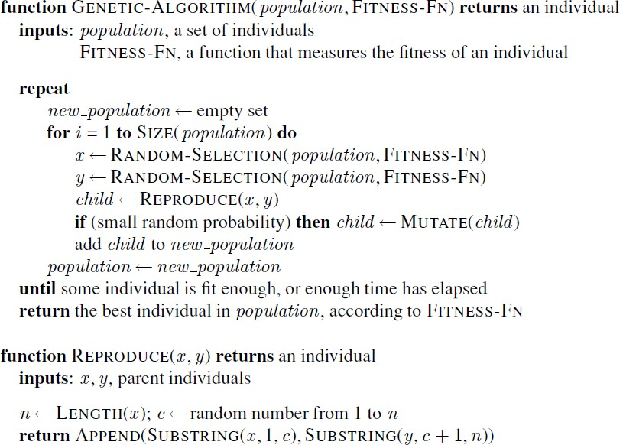
Genetic Algorithms
A genetic algorithm: each mating of two parents produces only one offspring, not two.

